Slide 1
Maps in Xamarin
Arora, Breitenfellner, Obermayr, Punz | 18 May 2017

Slide 2

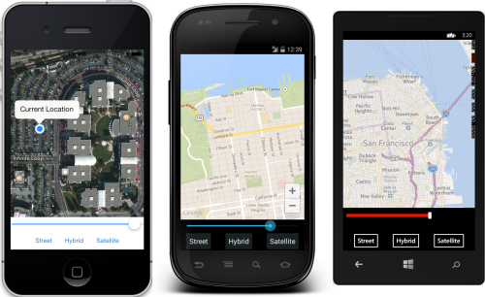
Maps in Xamarin
Use native Map-APIs
Apple Maps
Google Maps
(Bing Maps)

Slide 3
Getting started
Available through NuGet PM> Install-Package Xamarin.Forms.Maps
MapsSample linked on Xamarin Maps documentation
Can be used like any other Xamarin.Forms element <maps:Map WidthRequest="320" HeightRequest="200" x:Name="MyMap“ IsShowingUser="true“ MapType="Hybrid“ />

Slide 4
Setup
iOS requires two entries in Info.plist 1. NSLocationAlwaysUsageDescription 2. NSLocationWhenInUseUsageDescription
Enter your Google Maps API-Key
Call Xamarin.FormsMaps.Init()from…
AppDelegate.finishedLaunching (iOS)
MainActivity.OnCreate (Android)

Slide 5
Methods
Map type
Street (default)
Satellite
Hybrid map.MapType = MapType.Street;
Center and Zoom
Map.MoveToRegion(MapSpan) (MapSpan holds center-point and zoom-level)

Slide 6
Methods
Map pins var position = new Position(37,-122); var pin = new Pin { Type = PinType.Place, Position = position, Label = "custom pin", Address = "custom detail info“ }; map.Pins.Add(pin);

Slide 7
TK.CustomMap
Extension for Xamarin.Forms.Maps
Additional features
Easy customization of pins
React on map-clicks
…
Installation via NuGet
Problem with map-clicks under Android
Solution: directly use library from sample project

Slide 8
Open Street Maps
Technically possible
No easy solution like 1 NuGet package for all OSs
Existing packages
OSMDroid (for Android)
OSMSharp (for .NET)

Slide 9

Geo data – 1. Approach
Stadt Linz Open data http://data.linz.gv.at
700MB TIF-file
Very complex data structure
Hard to extract needed data

Slide 10

Geo data – 2. Approach
Use data from OSM (CSV-file)
Apply some filtering and cleaning 14.1971472;48.2209883;Neubau; 14.2974303;48.2903185;Unionkreuzung; 14.2997566;48.2913481;Hamerlingstraße; …
Converted to JSON
Uploaded to Firebase
Works!

Slide 11
Summary
Upside
Few lines of code needed
Only one implementation for most features needed
Pitfalls
Problems with entering Google Maps API-Key
Little functionality -> use TK.CustomMap

Slide 12
Problems using Xamarin
Android build problem under MacOS
both with Xamarin Studio and Visual Studio for Mac
Default keystore sometimes wasn‘t created
Bad experience with Xamarin Studio - preview rarely works
Only few components exist -> use third-party implementations

Slide 13
Problems with Firebase
Importing the datasets took very long
No possibility of extending existing datasets

Slide 14
NOW: Current status of project

